Slide 1
Module No 3
UiPath Studio Overview

Slide 2
Learning Objectives
Introduction of UiPath Studio
Working with UiPath Studio Web
Sequence, Flow Chart & Decision
Variables and arguments, Loops
Working with Recording

Slide 3
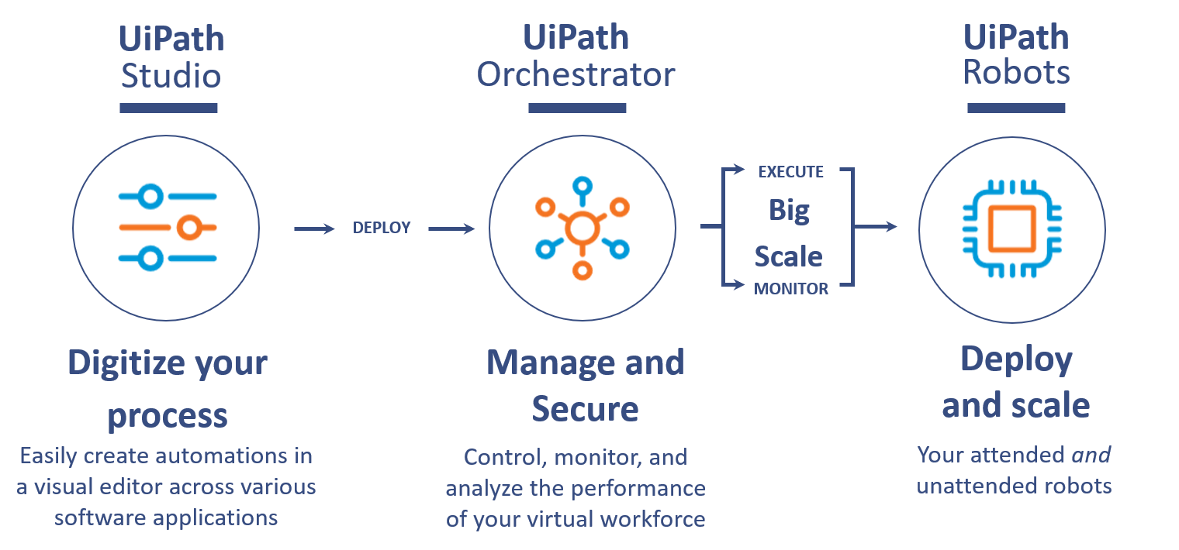
Introduction of UI Path Studio
UiPath Studio helps users with no coding skills to design Robotic processes in a visual interface. It is a flowchart-based modeling tool. Thus, automation is faster and more convenient. Multiple people can contribute to the same workflow. The presence of a visual signal that points out errors in the model, and a recorder that performs what the user executes, make modeling much easier.

Slide 4
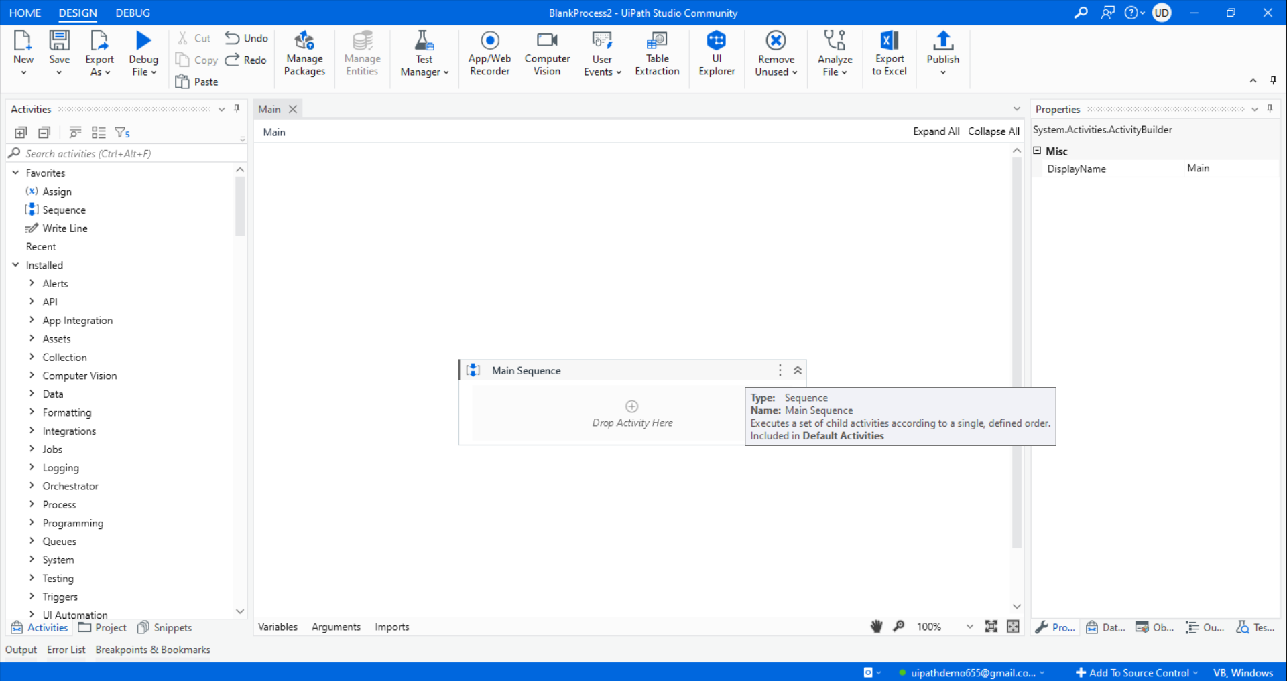
UI Path Studio Panels
The user interface:
The Ribbon
Designer panel
Properties panel
Outline panel
Arguments panel
Variable panel
Import panel
Activity panel
Library panel
Project panel
Output panel

Slide 5
Various Panels Details
The Ribbon – This panel located at the top of the user interface and consists of 3 tabs: Home, Design, Debug
Designer panel - This is the panel where one defines the steps and activities of the projects. It is where a developer does most of the things to record activities or manually drop activities on the canvas.
Properties panel - The panel located on the right-hand side of the user interface is for viewing the properties of the activities and for making any changes, if required. You need to select an activity first and then go to the Properties panel to view or change any of its properties.
Activities panel - Located on the left-hand side of the user interface, this panel contains all the activities that can be used in building the project. The activities can easily be used in making a project by simply dragging and dropping the required activity into the required location in the Designer panel.
Project panel- With the Project panel, you can view the details of your current project and open it in a Windows Explorer window.
Outline panel - As the name suggests, this panel gives a basic outline of the project. The activities that make up the workflow are visible in this panel. Using this, you may see a high-level outline of the project and you can drill down to see deeper.
Output panel- This panel displays the output of the log message or write line activities. It also displays the output during the debugging process. This panel also shows errors, warnings, information, and traces of the executed project. It is very helpful during debugging.
Variable panel - This allows the user to create variables and make changes to them. This is located below the Designer panel.
Argument panel- While variables pass data from one activity to another in a project, arguments are used for passing data from one workflow to another and also between different projects.

Slide 6
UiPath Studio Demo
Trainer Will Demo Each Panel of UiPath Studio...

Slide 7
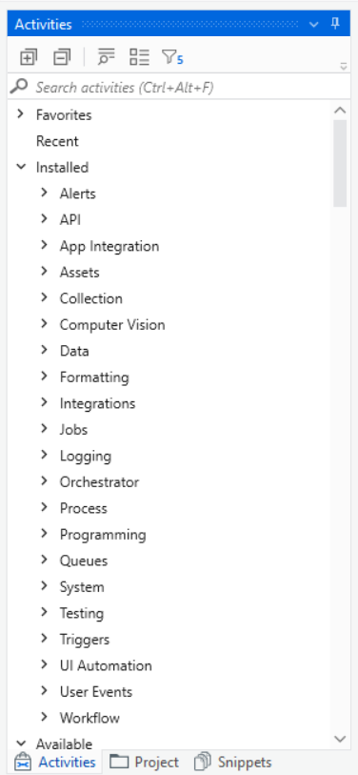
UiPath Studio Activities
In UiPath Studio, an activity represents the unit of an action. Each activity performs some action. When these activities combine together, it becomes a process.
Every activity resides on the Activities panel of the main Designer panel.
You can search for a particular activity and use it in your project. For example, when we search for browser, all the browser activities will appear in the Activities panel, as shown in the screenshot:
All activities are integrated into packages that cover certain areas of interest. For example, activities related to manipulating .xlsx or .csv files are organized under the UiPath.Excel.Activities package, making it easier for you to navigate through the list of available packages.

Slide 8
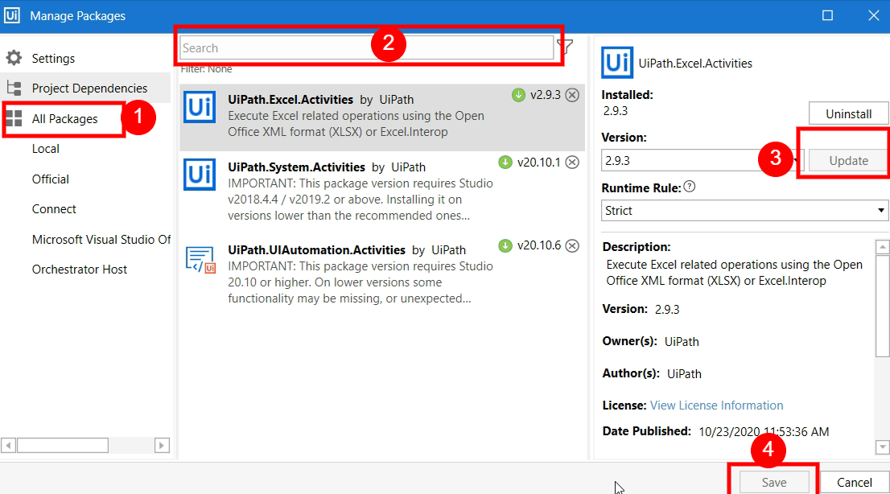
Manage UiPath Studio Activities
Default activities packages available by default in UiPath Studio as dependencies for all newly created projects.
UiPath Studio includes by default several activity packs, along with the following default process dependencies:
Uipath.Excel.Activities
UiPath.Mail.Activities
UiPath.System.Activities
UiPath.UIAutomation.Activities
Incase you wish to add new Package, Update Existing one, Or Install any third party provided Package you can manage that from Manage Packages Window.
The activities packages have a lifecycle strongly connected with the two annual Enterprise Releases and the monthly Community Releases.

Slide 9
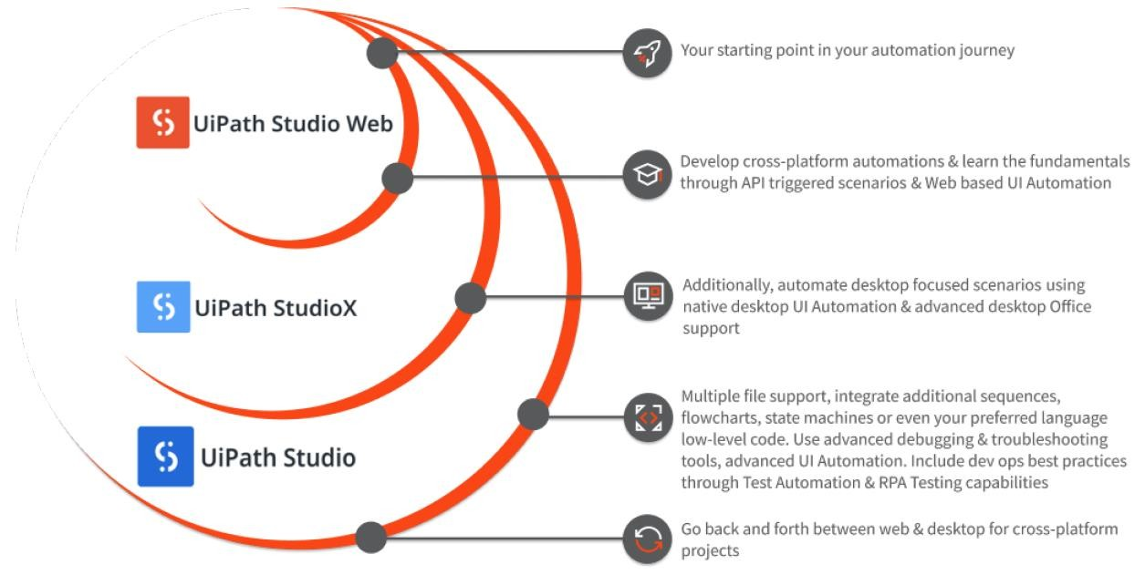
UiPath Studio Web
Demonstrating how manual triggers with UiPath Studio Web
Demonstrating how event-based triggers with UiPath Studio Web
Developing a process with UiPath Studio Web

Slide 10
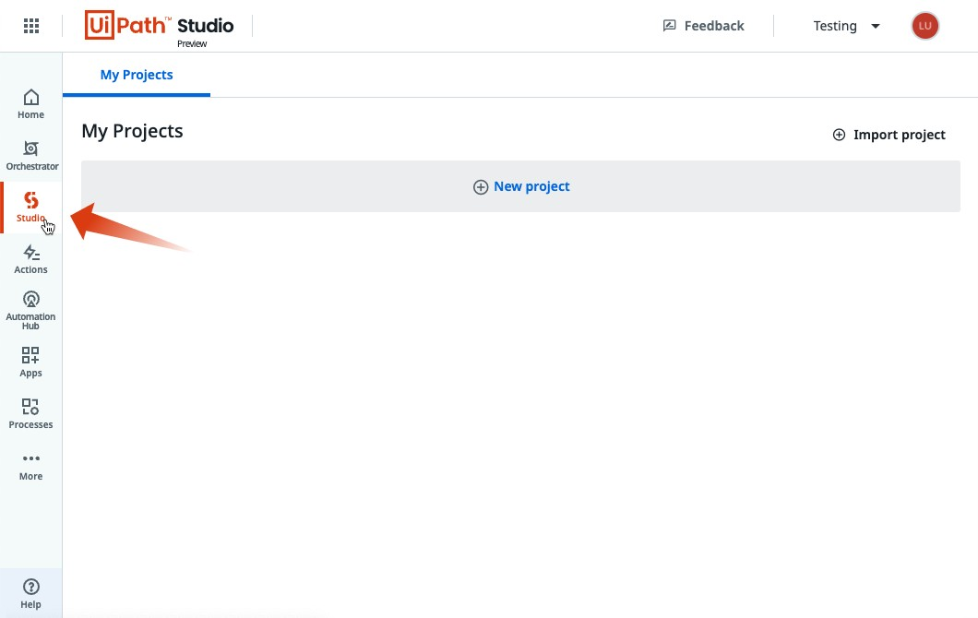
Why Studio Web
The benefits of starting with Studio Web include:
Quick Getting Started
Cross-Platform Ready
Integration Service
Compatible with Studio and StudioX
Schedule based on external events
Browser based UI Automation & Live Streaming
IT Automation Enabler
Easy-to-Deploy DU Scenarios
Share Projects with Teams

Slide 11
Variables
In UiPath Studio, variables are used to store multiples type of data. Another key aspect of
variables is that their value can change so that you can, for example, control how many times
the body of a loop is executed.
The data stored within a variable is called a value, and it can be of multiple types. UiPath, support a large amount of types, ranging from generic value, text, number, data table, time and date, to UiElements.
Not only this you can also create more complex variables like List, Array, Datatables and other .NET Language Supported types.
Creating Variables
There are 3 ways to create variables in UiPath:
From the Variables panel – Open the Variables panel, select the ‘Create new Variable’ option, and fill in the fields as needed. When you need it, provide its name in the Designer panel or in the desired Properties field.
From the Designer panel – Drag an activity with a variable field visible (i.e. ‘Assign’) and press Ctrl+K. Name it and then check its properties in the Variables panel.
From the Properties panel – In the Properties panel of the activity, place the cursor in the field in which the variable is needed (i.e. Output) and press Ctrl+K. Name it and then check its properties in the Variables panel.
Important Tips –
Make sure you define the scope of each variable correctly - remember that a variable defined on a limited scope cannot be used globally.
Use clear and consistent naming conventions - one of the most common is Camel case. Such as str_Name, or EmployeeName etc.
Making multiple variables unnecessarily causes confusion in large complex project.

Slide 12

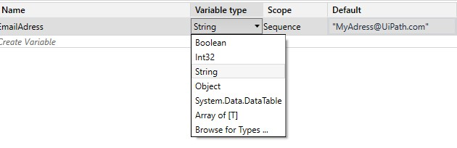
Data Types
With some exceptions, the data types in UiPath are borrowed from VB.Net
e.g. String, Int32, Boolean, Arrays, Lists, Datatables, etc.
UiPath has a proprietary variable type called GenericValue that can store any kind of data, including text, numbers, dates, and arrays.
String – System.String: used to store text
NUMERIC: there are different subtypes of numerical variables.
Int32 – System.Int32 (signed integers) e.g. 10, 299, -100
Long – System.Int64 (long integers) e.g. 5435435343O, -11332424D
Double – System.Double (allows decimals, 15-16 digits precision) e.g. 19.1234567891011
Boolean – System.Boolean: used to store one of two values i.e. True or False

Slide 13
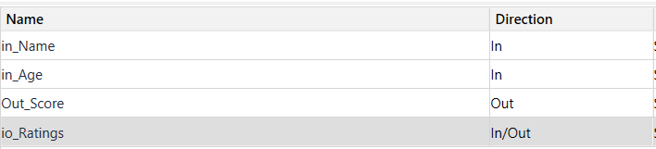
Arguments Purpose and use
An Argument is simply a variable that can store a value. You can create an argument in the Argument section of the main Designer panel.
An argument has a larger scope than a variable and is used to pass values between different workflows.
You might be wondering why we need this. Suppose we have a big project to build; we break down the project into different workflows because smaller workflows can be easily tested separately.
We can easily create arguments in the Arguments panel same like variable.
We can also specify the direction:
In: When we have to receive the value from another workflow.
Out: This is the current value if we have to send the value to a workflow.
In/Out: This specifies both; it can take or receive the value.
UiPath Studio supports a large number of types of arguments, which coincide with the types of variables. Therefore, you can create generic value, string, Boolean, object, array, data table arguments and you can also browse for .NET types, just as you do for variables.

Slide 14
Workflow 1
Workflow 2
Invoke Workflow 2
In: Take data to workflow 2
Out: Take data from workflow 2
In/Out: Take data from/to workflow 2

Slide 15
Example of Using an Argument & Variables
To exemplify how to use an argument in a workflow with an Invoke Workflow File activity, we are going to create two separate sequences. A very simple one in which to assign a value to an argument, and a second that invokes it and displays the value in a message box
Trainer Will Demo With Help of UiPath Studio...

Slide 16
What Is Workflows ?
A workflow represents a small piece of automation that you can take and re- use in your projects.
It is basically your canvas, the place where you design and work with all the UiPath Studio activities and it defines the flow of your automation.
Hence the name, workflow.
The fastest, most reliable, and useful way of automating a process is to break it down into smaller bits.
This allows for independent testing of components, enables team collaboration, and component reuse.
Hence, most of the automation projects require the use of multiple workflows that come together to provide a solid business automation solution.

Slide 17
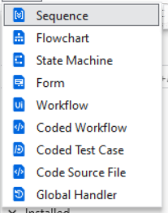
Types of Workflows
UiPath offers four diagrams for integrating activities into a working structure when developing a workflow file:
Sequence - Sequences are suitable for linear processes, as they enable you to smoothly go from one activity to another, without cluttering your workflow.
Flow Chart - Flowcharts are suitable to a more complex business logic, enabling you to integrate decisions and connect activities in a more diverse manner, through multiple branching logic operators.
State Machine- State Machines are suitable for very large workflow. They use a finite number of states in their execution which are triggered by a condition (transition) or activity.
Global Handler- For determining the workflow behavior when encountering an execution error, and for debugging processes, Global Exception Handler is most suited.
Many New Types of Workflows are added recently such as Form, Coded Workflow, Coded Test Case, Coded Source File, Global Handler

Slide 18
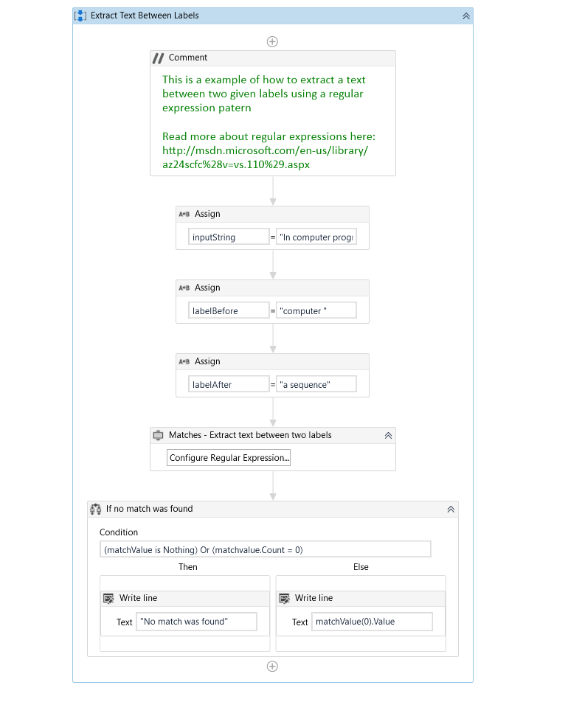
Types of Workflows
What is a Sequence?
A Sequence is a group of logical steps. Each step represents an action or a piece of work. A Sequence is used for processes that happen in linear succession, that is, one after the other.
Among the three types of Workflows in UiPath, Sequences are the simplest.
You can Search for “Sequence” in the Activities panel and then drag and drop it into the On the Designer panel.
Sequence can be also used inside flowchart.

Slide 19
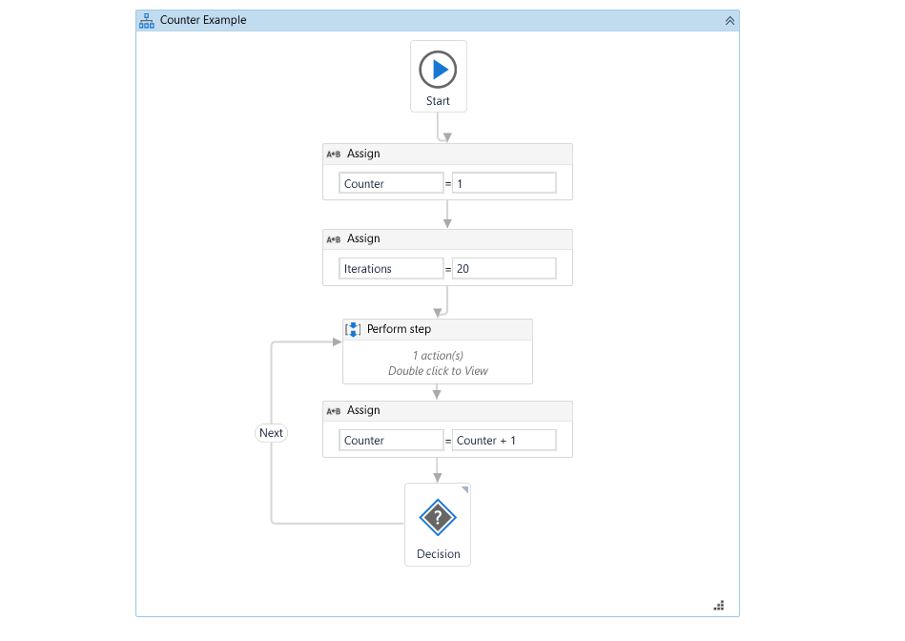
Flowcharts
What is a Flowchart ?
A Flowchart is generally used for complex business processes. It provides decision-making facilities and can be used for both small and large projects.
A Flowchart provides multiple branching logical operators to make decisions. A Flowchart is able to run in reverse.
Also, it can be used inside Sequences.
A Flowchart's branches are set to true/false by default. However, its names can be manually changed from the Properties panel.

Slide 20
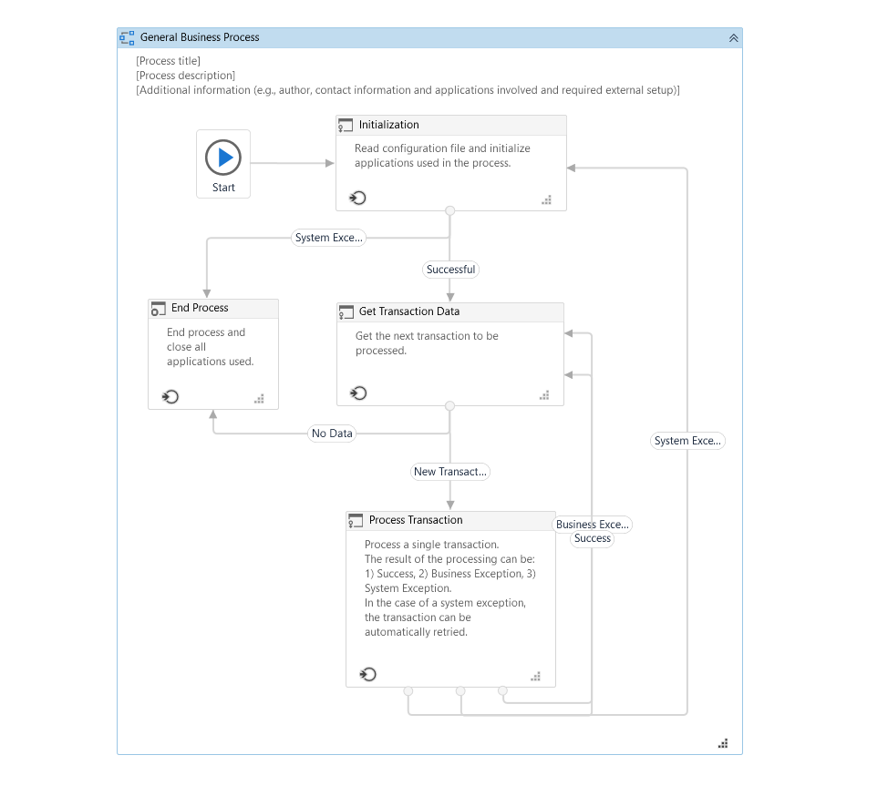
State Machines
A state machine is a type of workflow that uses a finite number of states in its execution.
It can go into a state when it is triggered by an activity, and it exits that state when another activity is triggered.
Another important aspect of state machines are transitions, as they also enable you to add conditions based on which to jump from one state to another.
These are represented by arrows or branches between states.
There are two activities that are specific to state machines, namely State and Final State, and they are found under Workflow > State Machine.
**More Details on State Machine Will be covered in future modules with RE Framework.

Slide 21
UiPath Workflow Demo
Trainer Will Demo Quick Example Using UiPath Studio...

Slide 22
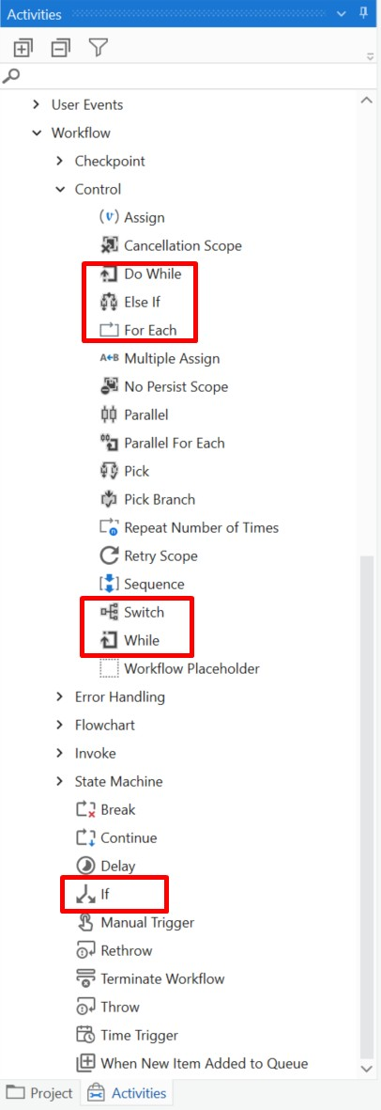
UiPath Control Flow Decision and Loops
Control flow takes care of the order in which the actions are performed in
automation.
Activities like If/Else If, For Each, enable us to define rules and automate conditional statements within the project.
Loops enable us to run a part of the automation a specific number of times until a condition is met, or indefinitely.

Slide 23
UiPath Control Flow Decision and Loops
These activities, present in the Activities panel, are put into the workflow either using the double-click method or the drag and drop method.
Important control flow activities are as follows:
Assign activity
Delay activity
Break activity
Continue
While activity
Do While activity
For each activity
If activity
Switch activity

Slide 24
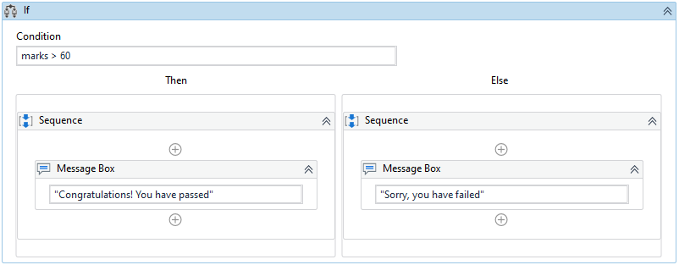
Conditional Control Statements - If
Contains a statement with a condition, and two sets of instructions (Then & Else) as outcomes
Then: the set of actions to be executed when the condition is True
Else: the set of actions to be executed when the condition is False

Slide 25
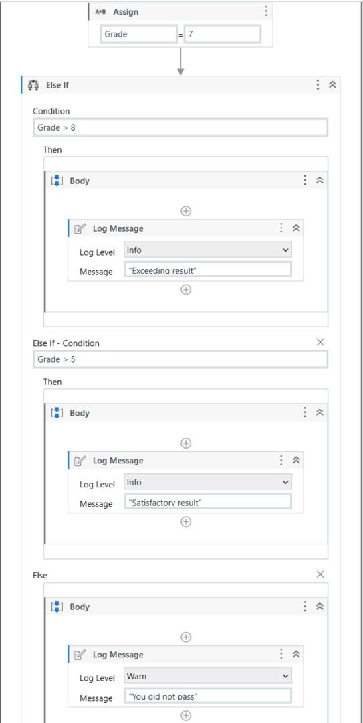
Conditional Control Statements - Else If
It comes with the ability to add multiple
conditions to the Else branch.
If the first condition is met, then you perform the action under it.
If not, you can add another condition using the second Else If and if the condition is True, then perform the action under it. If not, add another condition using Else If.
Else, if none of the conditions are met, then you
perform the last action under Else.

Slide 26

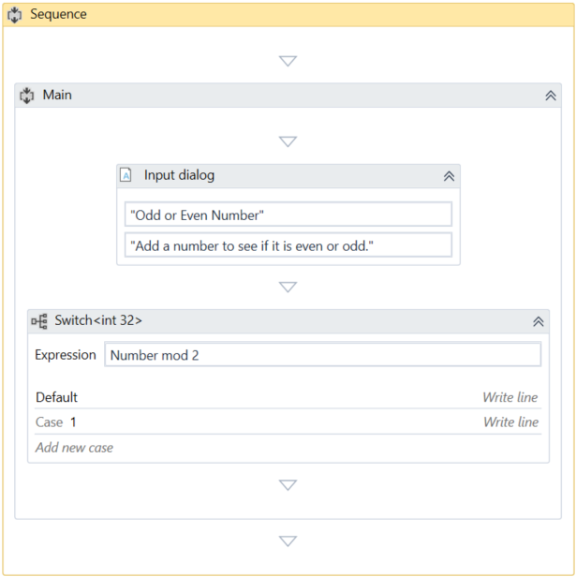
Conditional Control Statements - Switch
Executes a set of activities out of multiple, based on the value of a specific expression. Useful when we need at least three potential sources of action.
★ Switch evaluates once; Else If evaluates each time.
Business Cases to use Switch Statement
An invoice that has three potential statuses (not started, pending, approved) and three sets of actions for each one.
A process of automatically ordering raw materials to four suppliers based on certain conditions.

Slide 27

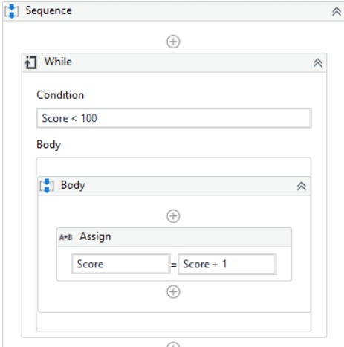
Conditional Control Statements: Loops - While
While
It executes a specific sequence while a condition is met. The condition is evaluated before each execution of the statements.
It is possible for a While loop to have zero executions!

Slide 28

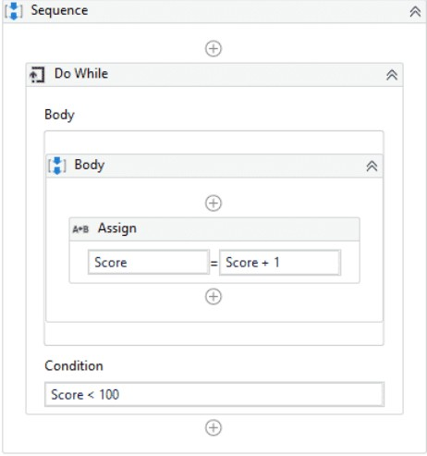
Conditional Control Statements: Loops - Do While
Loops are repetitions of a set of operations based on a given condition.
Do While
It executes a specific sequence while a condition is met. The condition is evaluated after each execution of the statements
This is a quite different scenario than the While loop.
In the body of the loop, a robot could perform a refresh command on a website and then check if a relevant element was loaded. It will continue the refresh - check cycle until the element is loaded. .

Slide 29

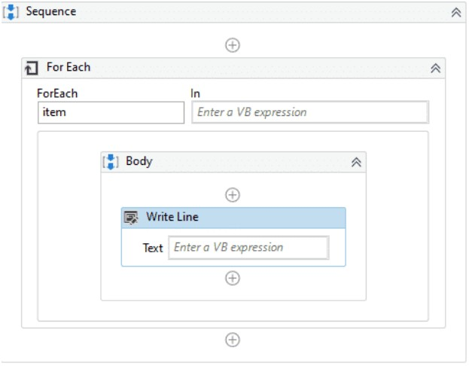
Conditional Control Statements: Loops - For Each
For Each
It performs an activity or a series of activities on each element of an input collection.
This is very useful in data processing. Consider an Array of integers. For Each would enable the robot to check whether each numeric item fulfills a certain condition.

Slide 30
How to exit a loop?
Loops are fun, but you should know how to stop the ride at some point. There are multiple ways to exit a loop:
The While and Do While loops will exit when upon checking, the condition is no longer
true.
The For Each loop will exit when it has finished processing every item in the input collection.
The Break activity enables you to exit the current loop activity (e.g. For Each, While, or Do
While) at a chosen point and continues the workflow with the activity that follows it.
The Continue activity enables you to skip the remaining steps in the current iteration inside a loop activity, such as For Each, While, or Do While loop.

Slide 31
Example of control flow activities
Trainer Will Demo With Help of UiPath Studio...

Slide 32
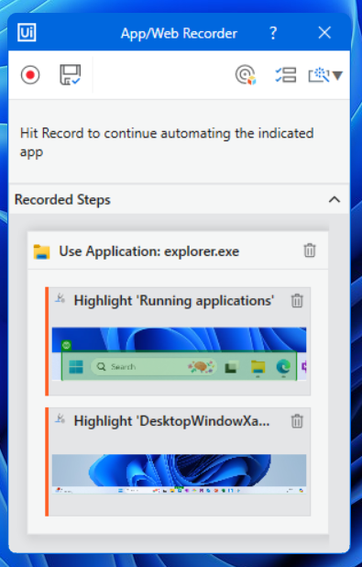
Recording With UiPath
Recording is an important part of UiPath Studio, that can help you save a lot of time when automating your business processes.
This functionality enables you to easily capture a user’s actions on the screen and translates them into sequences.
These workflows can be modified and parametrized so that you can easily replay and reuse them in as many other processes as you need.
App/Web Recorder (v20.8.0+)
All user interface elements are highlighted while you record so that you can be sure the correct buttons, fields, or menus are selected.
The recorder captures a default action for each type of UI element and also allows you to manually choose the desired action before performing it.
The recorder displays a preview of the activities that will be added to your project in real time.
The preview includes informative screenshots that are also added to the activities in the automation project.
All screenshots are saved as .png files in a folder named .screenshots inside the project folder.

Slide 33
Example of Using an App/Web Recorder
Trainer Will Demo With Help of UiPath Studio...

Slide 34
References
https://docs.uipath.com/activities/docs/introduction
https://docs.uipath.com/activities/docs/app-web-recorder

